Slide 1
Simple Regression
Relationship with one
independent variable

Slide 2
Lecture Objectives
You should be able to interpret Regression Output. Specifically,
  Interpret Significance of relationship (Sig. F)
  The parameter estimates (write and use the model)
  Compute/interpret R-square, Standard Error (ANOVA table)

Slide 3
Basic Equation
ŷ = b₀ + b₁X
є
Dependent variable (y)
b₁ = slope
= ∆y/ ∆x
b₀ (y intercept)
Independent variable (x)
The straight line represents the linear relationship between y and x.

Slide 4
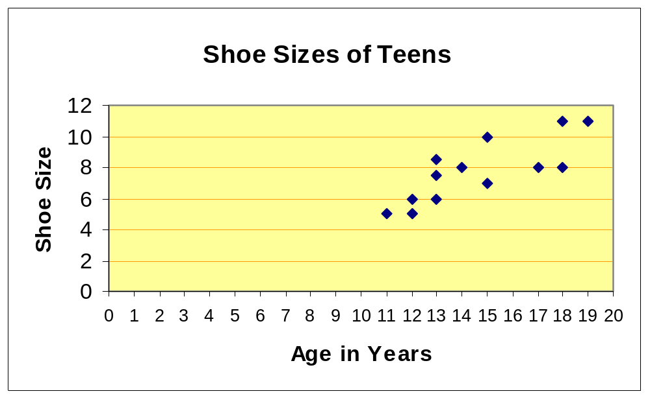
Understanding the equation
What is the equation of this line?

Slide 5
Total Variation Sum of Squares (SST)
What if there were no information on X (and hence no regression)? There would only be the y axis (green dots showing y values). The best forecast for Y would then simply be the mean of Y. Total Error in the forecasts would be the total variation from the mean.
Variation from mean (Total Variation)
Mean Y
Dependent variable (y)
Independent variable (x)

Slide 6
Sum of Squares Total (SST) Computation
 | Shoe Sizes for 13 Children
 | X | Y | Deviation | Squared
Obs | Age | Shoe Size | from Mean | deviation
1 | 11 | 5.0 | -2.7692 | 7.6686
2 | 12 | 6.0 | -1.7692 | 3.1302
3 | 12 | 5.0 | -2.7692 | 7.6686
4 | 13 | 7.5 | -0.2692 | 0.0725
5 | 13 | 6.0 | -1.7692 | 3.1302
6 | 13 | 8.5 | 0.7308 | 0.5340
7 | 14 | 8.0 | 0.2308 | 0.0533
8 | 15 | 10.0 | 2.2308 | 4.9763
9 | 15 | 7.0 | -0.7692 | 0.5917
10 | 17 | 8.0 | 0.2308 | 0.0533
11 | 18 | 11.0 | 3.2308 | 10.4379
12 | 18 | 8.0 | 0.2308 | 0.0533
13 | 19 | 11.0 | 3.2308 | 10.4379
 |  |  |  | 48.8077 | Sum of Squared
 | Mean | 7.769 | 0.000 |  | Deviations (SST)
In computing SST, the variable X is irrelevant. This computation
tells us the total squared deviation from the mean for y.

Slide 7
Error after Regression
Total Variation
Residual Error (unexplained)
Explained by regression
Dependent variable (y)
Mean Y
Independent variable (x)
Information about x gives us the regression model, which does a better job of predicting y than simply the mean of y. Thus some of the total variation in y is explained away by x, leaving some unexplained residual error.

Slide 8
Computing SSE
Shoe Sizes for 13 Children
 | X | Y |  | Residual
Obs | Age | Shoe Size | Pred. Y | (Error) | Squared
1 | 11 | 5.0 | 5.5565 | -0.5565 | 0.3097
2 | 12 | 6.0 | 6.1685 | -0.1685 | 0.0284
3 | 12 | 5.0 | 6.1685 | -1.1685 | 1.3654
4 | 13 | 7.5 | 6.7806 | 0.7194 | 0.5176
5 | 13 | 6.0 | 6.7806 | -0.7806 | 0.6093
6 | 13 | 8.5 | 6.7806 | 1.7194 | 2.9565
7 | 14 | 8.0 | 7.3926 | 0.6074 | 0.3689
8 | 15 | 10.0 | 8.0046 | 1.9954 | 3.9815
9 | 15 | 7.0 | 8.0046 | -1.0046 | 1.0093
10 | 17 | 8.0 | 9.2287 | -1.2287 | 1.5097
11 | 18 | 11.0 | 9.8407 | 1.1593 | 1.3439
12 | 18 | 8.0 | 9.8407 | -1.8407 | 3.3883
13 | 19 | 11.0 | 10.4528 | 0.5472 | 0.2995
 |  |  |  | 0.0000 | 17.6880 | Sum of Squares
Prediction |  | Intercept (bo) | -1.17593 |  |  | Error
Equation: |  | Slope (b1) | 0.612037

Slide 9
The Regression Sum of Squares
Some of the total variation in y is explained by the regression, while the residual is the error in prediction even after regression.
Sum of squares Total =
Sum of squares explained by regression +
Sum of squares of error still left after regression.
SST = SSR + SSE
or, SSR = SST - SSE

Slide 10
R-square
The proportion of variation in y that is explained by the regression model is called R².
R² = SSR/SST = (SST-SSE)/SST
For the shoe size example,
R² = (48.8077 – 17.6879)/48.8077
= 0.6376.
R² ranges from 0 to 1, with a 1 indicating a perfect relationship between x and y.

Slide 11
Mean Squared Error
MSR = SSR/df_{regression}
MSE = SSE/df_{error}
df is the degrees of freedom
For regression, df = k = # of ind. variables
For error, df = n-k-1
Degrees of freedom for error refers to the number of observations from the sample that could have contributed to the overall error.

Slide 12
Standard Error
Standard Error (SE) = √MSE
Standard Error is a measure of how well the model will be able to predict y. It can be used to construct a confidence interval for the prediction.

Slide 13
Summary Output & ANOVA
SUMMARY OUTPUT
Regression Statistics
Multiple R | 0.798498
R Square | 0.637599
Adjusted R Square | 0.604653
Standard Error | 1.268068
Observations | 13
= SSR/SST = 31.1/48.8
= √MSE = √ 1.608
ANOVA
 | df | SS | MS | F | Significance F
Regression | 1 (k) | 31.1197 | 31.1197 | 19.3531 | 0.0011
Residual (Error) | 11 (n-k-1) | 17.6880 | 1.6080
Total | 12 (n-1) | 48.8077
p-value for
regression
=MSR/MSE
=31.1/1.6

Slide 14

The Hypothesis for Regression
H₀: β₁ = β₂= β₃ = … = 0
H_{a}: At least one of the β_{s} is not 0
If all βs are 0, then it implies that y is not related to any of the x variables. Thus the alternate we try to prove is that there is in fact a relationship. The Significance F is the p-value for such a test.

